Slide 1
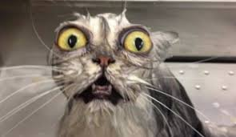
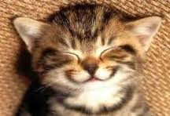
Working Together For Social & Emotional Health

Slide 2
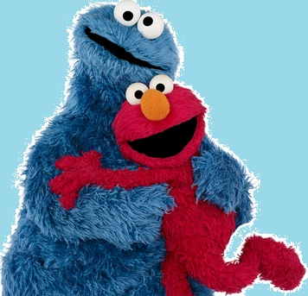
Self-Regulation
The Why
The What
The How
Mind-Up: The Hawn Foundation
Friends For Life: Dr. Paula Barrett
The Zones of Regulation: Leah Kuypers
Calm, Alert and Learning: Stuart Shanker
Superflex: Stephani Madrigal & Michelle Garcia
“How Does Your Engine Run?”: Mary Sue Williams & Sherry Shellenberger

Slide 3
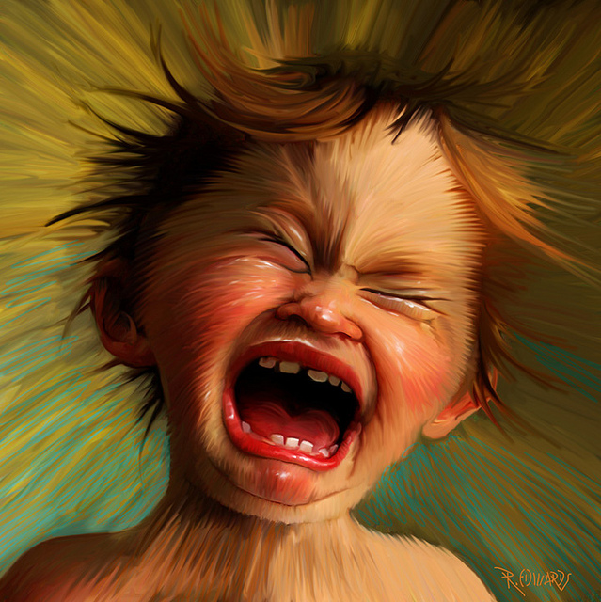
Especially in today’s world we need to help children self-regulate!

Slide 4
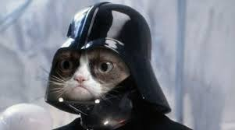
Understanding Five Basic Concepts
Practicing Simple Self-Regulation Skills
Anyone can become more powerful with the force of self-regulation.

Slide 5
The Five Basics Concepts:
Neuroplasticity:
We can help our brain to change and grow.
The Three Key Players:
Our prefrontal cortex (The Wise Leader)
Our amygdala (The Security Guard)
Our hippocampus (The Filing Cabinet)
Every Emotion Is Valuable:
Every emotion allows us to understand life and motivates us to respond to life.

Slide 6
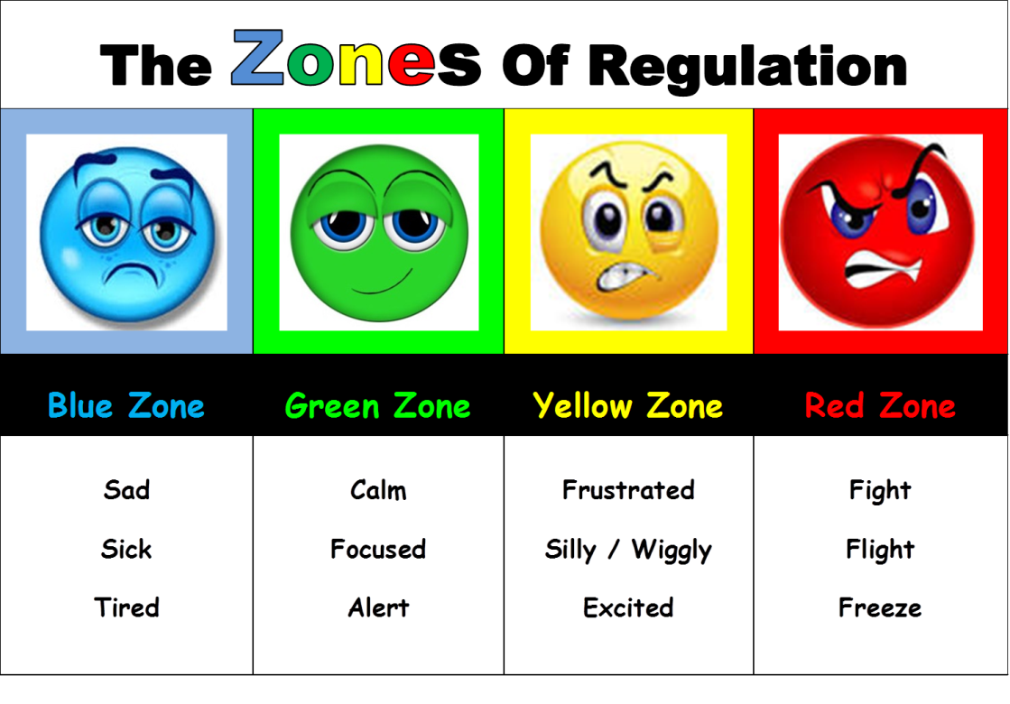
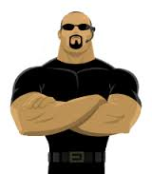
Emotions come with energy
Blue Zone Energy: A low energy level that is commonly experienced when feeling sick, sad, lonely, or tired.
Green Zone Energy: An alert, calm energy level that is commonly experienced when happy, or interested in the present moment.
Yellow Zone Energy: A high energy level that is commonly experienced when either excited, and having fun, or when anxious / frustrated by something.
Red Zone Energy: An extremely high energy level that is commonly experienced when very angry, mad or afraid.
Each colour or zone represents an emotional energy level.

Slide 7
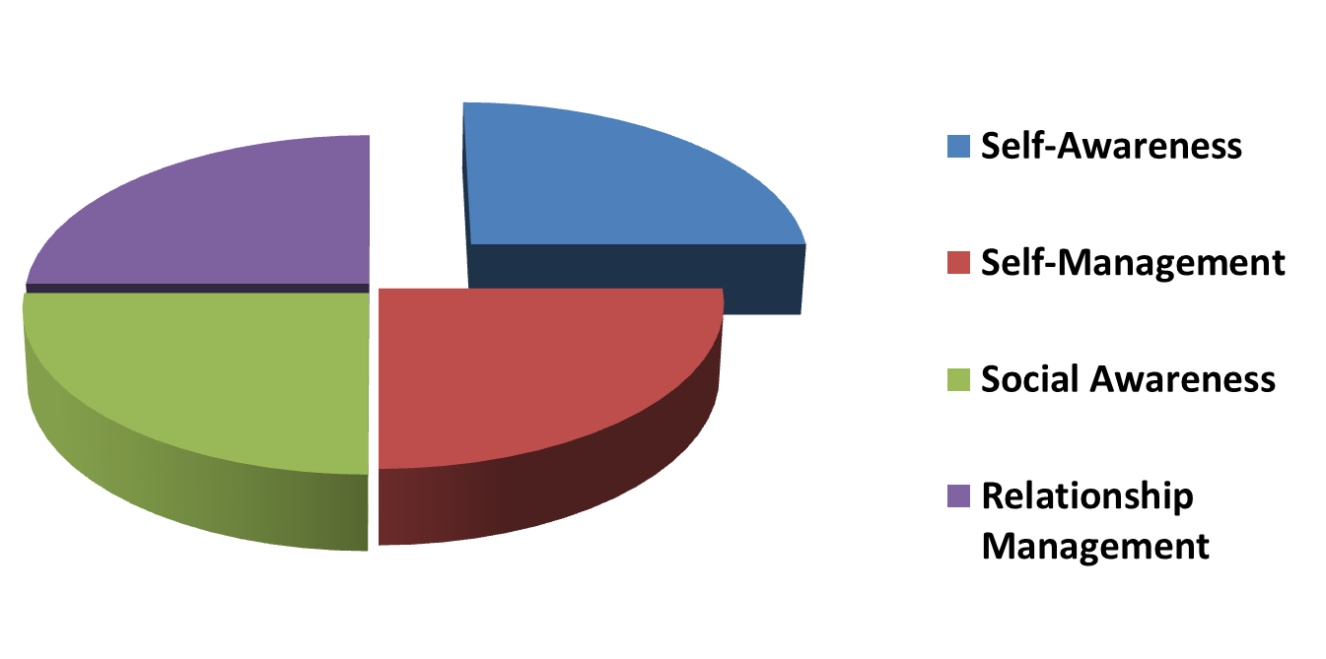
Self-Awareness: (the beginning of self-regulation)
A person can not manage something if they are not aware of it.
The first skill that must be practiced is the awareness of one’s own emotional energy.
According to Dr. Stuart Shanker, author of “Calm, Alert, and Learning,” children as young as age 4 can learn self-awareness / self-regulation.

Slide 8
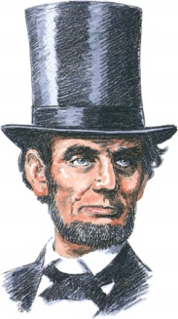
Our Brain’s
Wise Leader
(PFC)

Slide 9
The Wise Leader
The Learning, Reasoning, Thinking Centre

Slide 10
Our Brain’s
Security Guard
(Amygdala)

Slide 11
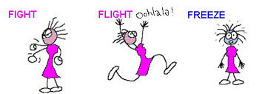
Security Guard
Reacts immediately to
Fear, Danger and Threat

Slide 12
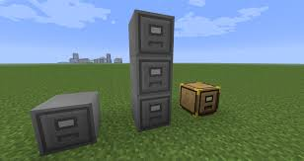
Our Brain’s
Filing Cabinet
(Hippocampus)

Slide 13
Storage Files
for
memories and learning

Slide 14
How do these 3 parts work with each other?

Slide 15
When we are feeling alert and calm
Amygdala
Prefrontal Cortex
Sensory Input
Conscious Response
Hippocampus

Slide 16
When we are feeling stressed or afraid
Sensory Input
Amygdala
Prefrontal Cortex
Fight, Flight, or Freeze Response
Hippocampus

Slide 17
One Brain / Two Paths
Amygdala
Prefrontal Cortex
Sensory Input
Conscious Response
Prefrontal Cortex
Amygdala
Fight, Flight, or Freeze Response

Slide 18
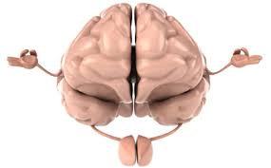
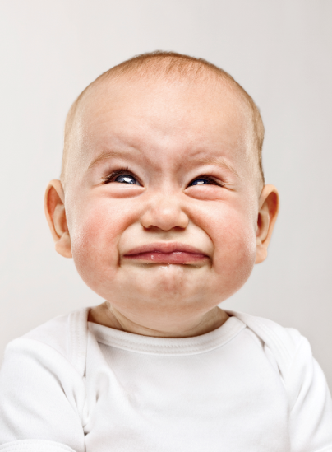
Two Brains In One

Slide 19
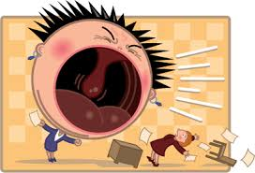
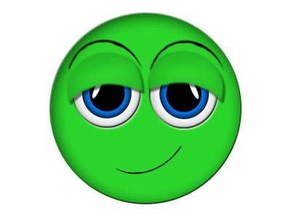
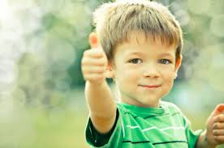
The security guard (Amygdala) helps us to be aware of our world, but once we have a functioning wise leader (Prefrontal Cortex), we don’t want him to be in charge anymore.

Slide 21
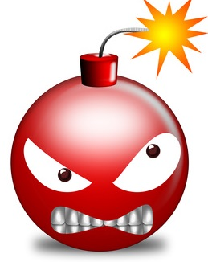
Our security guard does not have a key for our filing cabinet.
When we get into the RED ZONE our security guard can take us over.
This leaves us with no access to our learning, and only three behaviour options:

Slide 22
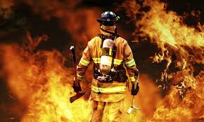
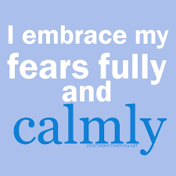
A person can experience every emotion in the green energy.
It is possible to be very angry, embarrassed, sad, or afraid, and yet at the same time be calm.
When we are calm in the green zone, our wise leader is strongest. Our wise leader has the key to open our filing cabinet to access all our memories / learning.
No matter what problem we are faced with, it is always better to have
the wise leader in charge!

Slide 23
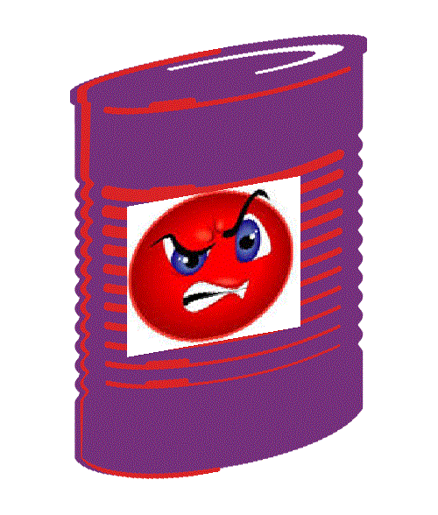
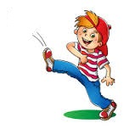
It is Ok to be in the low energy blue zone, or in the high energy yellow zone, however it is important to know when you are in these zones. Both the blue and yellow zones are next to the red zone. We should NEVER be in the red zone once we have a wise leader.
If you picture the zone chart wrapped around a can you will see that both the blue and yellow zones are next to the red zone. In the can is all the stress and issues of daily life.

Slide 24
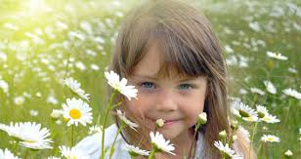
Even though it is important to experience the blue and yellow emotional energy, it is necessary to have the skills to move back into the green zone. For example, if a child’s energy is in the yellow zone after playing outside during recess, it is important to be able to move back into the green zone when returning to a classroom lesson. The green zone is best for learning since the wise leader (PFC) is strongest in this calm, alert energy.
If a person is not aware of their emotional energy zones, or does not have the skills to move themselves back into the green zone, they will be in constant risk of falling into the red zone. This will result in more social and emotional struggles in life.

Slide 25
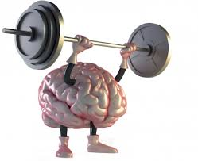
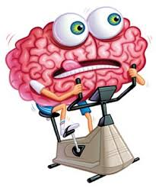
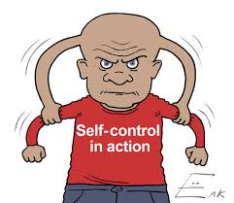
Practicing Simple
Self-Regulation Skills
Power through Practice!

Slide 26
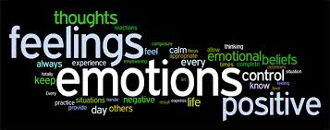
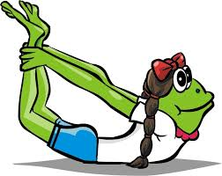
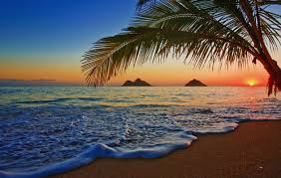
Managing Emotional Energy
We can manage emotional energy by practicing simple skills.
The skills focus on three areas:
Managing our emotional energy through our thoughts.
Green Thoughts vs. Red Thoughts
Guided Imagery
Goal setting, etc…
Managing our emotional energy through our bodies.
Stretching, music, dance, breathing
Diet, sleep, exercise, etc…
Managing our emotional energy through our environment.
Calm work space, lighting, sound, etc…

Slide 27
Blue to Green Zone Moving our energy level up
Move
Wiggle toes
Bounce knees
Chair Push-Up
Stand
Dance
Walk
Fidget item
Mouth
Fig. 8 Breathing
Deep Breathing
Sing
Eat
Drink Water
Ask A Question

Slide 28
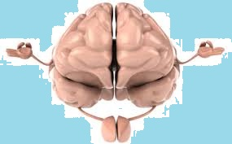
Red / Yellow to Green Zone
Moving our energy level down
Mouth:
Talking to adult
Belly Breathing
Figure 8 Breathing
Singing
Drinking
Eating
Move:
Exercising
Dancing
Muscle Relaxation
Drawing /Writing
Fidget Item
Walking
Standing
Mind:
Share feelings
Guided imagery
Size of the problem
Red thoughts/Green thoughts
Listening to calm music
Reading
Coaching (tools below)
Counting to 10
(examples on next slide)

Slide 29
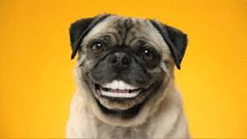
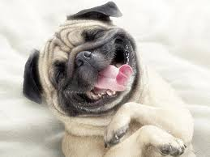
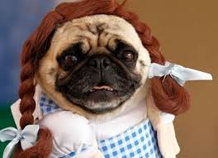
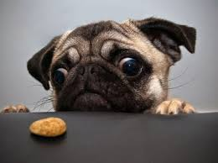
Counting to 10
One | One thing that makes me smile
Two | Two things that make me laugh
Three | Three people that care about me
Four | Four things I can do to help me feel good…
Engaging mind, body, and mouth to down regulate emotional energy

Slide 30
Name:
Date:
Draw Your Zone Story:
What did it look like?
Draw Your Green Zone Story:
What could it have looked like?
Tell Your Zone Story:
What happened & how it felt?
Tell Your Green Zone Story:
What could have happened & how it could have felt?

Slide 31
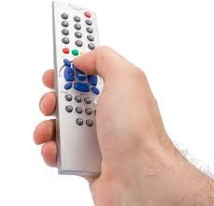
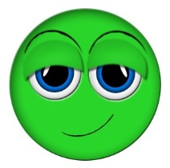
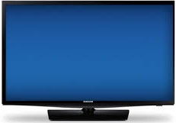
Change Your Channel
What Did It Look Like?
What Could It Look Like?

Slide 32
